Slide 1


GROMACS-CP2K Interface Tutorial (Introduction to QM/MM simulations)
Dmitry Morozov
University of Jyväskylä, Finland
dmitry.morozov@jyu.fi

Slide 2


Practical: GROMACS + CP2K Part I
Lecture recap
Gromacs-CP2K interface for QM/MM
Setting up a QM/MM calculation
CP2K input and output
MM
QM

Slide 3
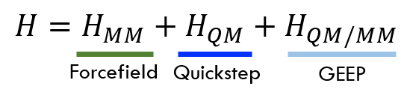
Lecture Recap: Forcefield (MM) - GROMACS
Force field description of MM region
MM
QM

Slide 4
Lecture Recap: Quickstep (QM) - CP2K
QM region as CP2K input
Guess density from Gaussian basis
Construct KS matrix and energy functional
MM
Map basis onto Real Space multi-grids
(Collocation and Interpolation)
QM
FFT to pass RS onto Reciprocal Space (G)
Minimize energy to obtain new density matrix
NO
YES
Energy, Forces and other properties
Convergence?

Slide 5
Practical: GROMACS + CP2K Part I
Lecture recap
Gromacs-CP2K interface for QM/MM
Setting up a QM/MM calculation
CP2K input and output

Slide 6

GROMACS-CP2K Interface
Quickstep: Mixed Gaussian and Plane wave basis implementation of Density Functional Theory
+
GEEP: Gaussian Expansion of Electrostatic Potential (GEEP) to compute the QM/MM coupling
MM
QM
Forcefield: Classical MM-MM interactions both bonded and non-bonded (PME)
+
Integration: Classical MD using fully periodic QM/MM forces

Slide 7
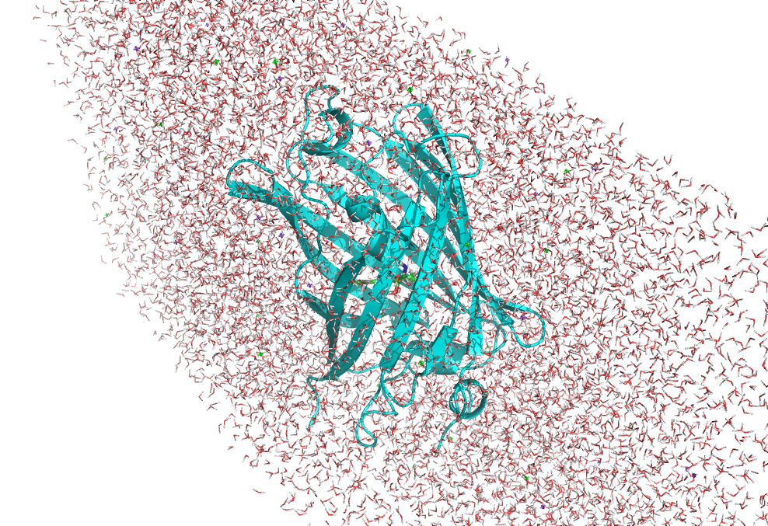
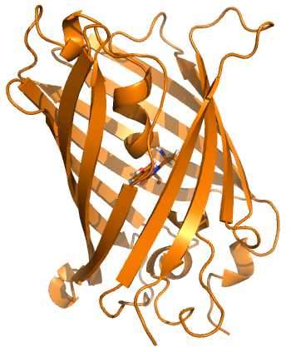
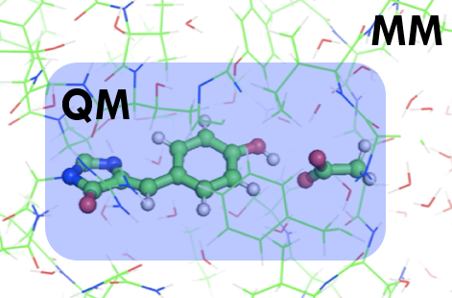
Features of the Interface
MD setup
QM/MM setup
Input protein structure
MD topology and parameters
QM/MM parameters
Automatized topology conversion from classical MD to QM/MM: charges and bonds modifications, as well as link-atoms setup on the frontier
Validated CP2K QM parameters setup for the biological systems
Compatibility with the most simulation techniques available in Gromacs
Compatibility with Gromacs tools and third-party software for analysis
Supports highly parallelizable simulation methods, like umbrella sampling

Slide 8
Practical: GROMACS + CP2K Part I
Lecture recap
Gromacs-CP2K interface for QM/MM
Setting up a QM/MM calculation
CP2K input and output

Slide 9
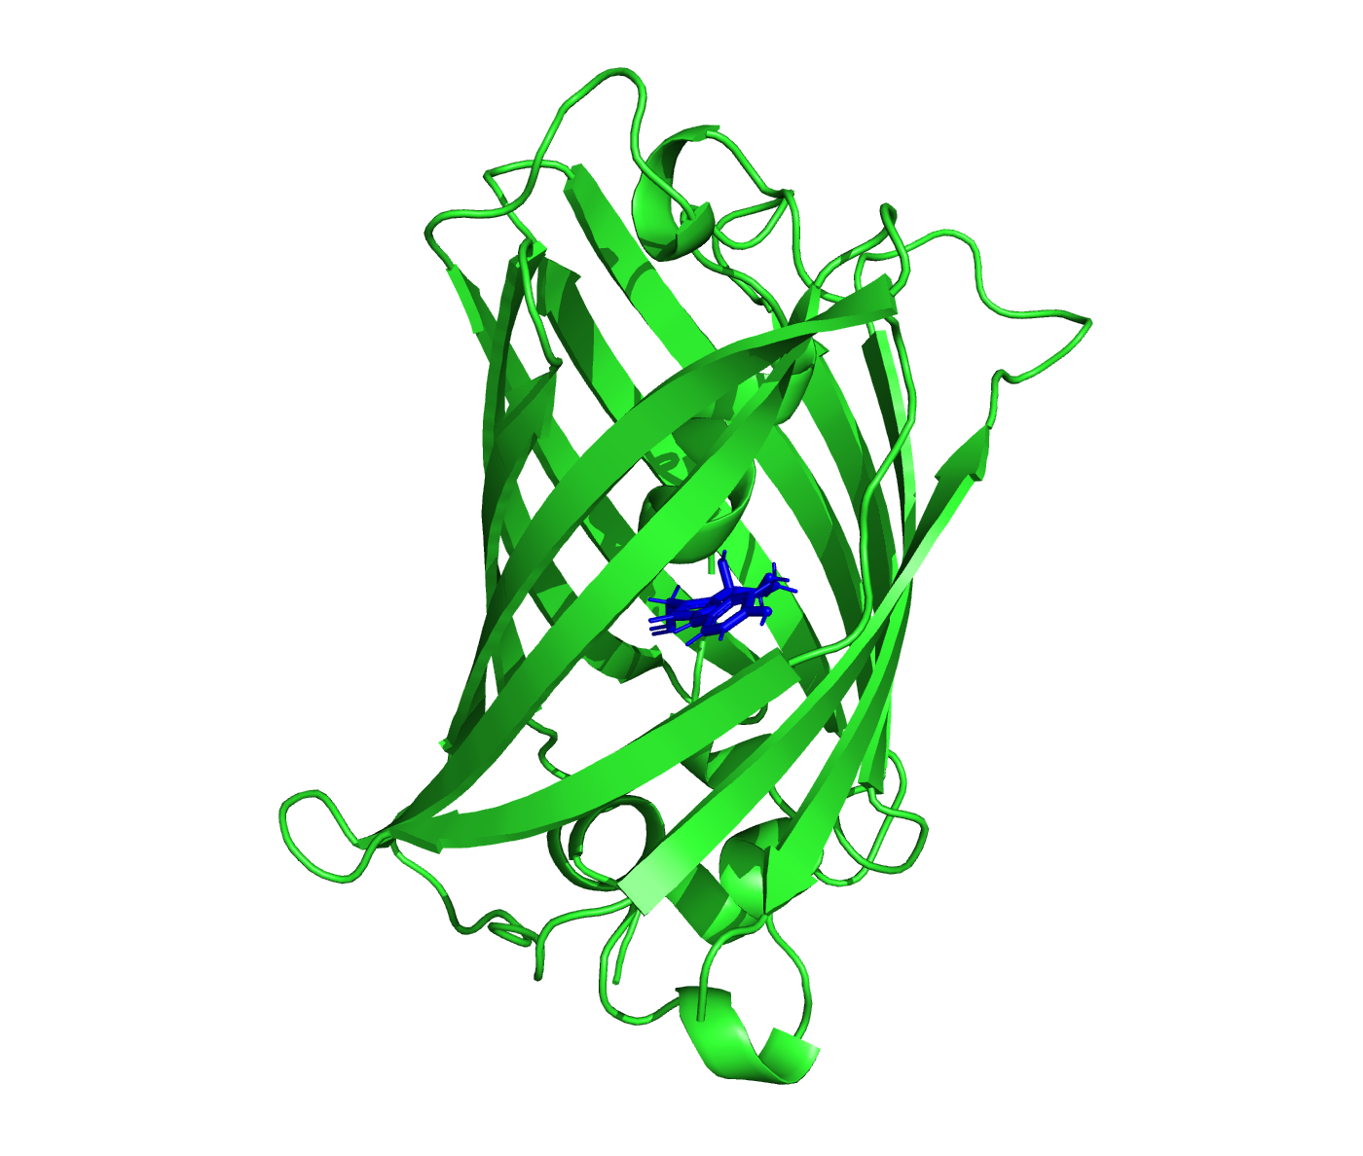
Setup a QM/MM calculation
Input structure
SYSTEM SETUP
MD SIMULATIONS
QM/MM Calculations
- Missing residues
- Residue protonation
- pdb2gmx
- Define box
- Add solvent and ions
- ….
- Prepare .mdp files
- Energy minimization
- Pressure & temperature equilibration
- Production run
…
- Index file
- .mdp parameters for QM/MM
-External CP2K input (optional)
- Geometry optimization
- Atomic charges
- QM/MM MD
- Absorption spectra
- Umbrella Sampling
- ….

Slide 10
GROMACS-CP2K Tutorial files
Open “Practical: GROMACS + CP2K Part I” episode.
Open terminal window and finish “Setting up tutorial environment part”
>> module load gromacs-cp2k
>> cd /work/ta025/ta025/<your login name>
>> git clone https://github.com/bioexcel/2021-04-22-gromacs-cp2k-tutorial.git tutorial
>> cd tutorial

Slide 11
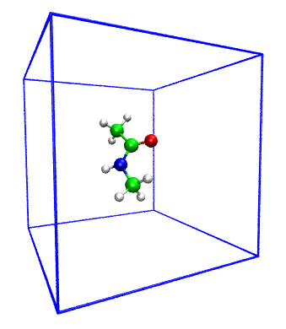
Exercise 1: Setting up simple QM system
Objective: Make simple QM system with interface
QM subsystem : NMA molecule (12 atoms)
MM subsystem : No
QM charge: 0
QM multiplicity: 1
Functional: PBE
Do the steps (1)-(5) from the “Exercise 1”

Slide 12
MDP Parameters for energy minimization
integrator = steep ; Algorithm (steep = steepest descent minimization)
emtol = 10.0 ; Stop minimization when the maximum force < 10.0 kJ/mol/nm
emstep = 0.01 ; Energy step size
nsteps = 100 ; Maximum number of (minimization) steps to perform
; Set output frequency to each step
nstxout = 1 ; Coordinates to trr
nstlog = 1 ; Energies to md.log
nstcalcenergy = 1 ; Energies
nstenergy = 1 ; Energies to ener.edr
; Set cut-offs
rlist = 0.2 ; NB-search cut-off
rcoulomb = 0.2 ; Short-range electrostatic cut-off
rvdw = 0.2 ; Short-range Van der Waals cut-off
; CP2K QMMM parameters
qmmm-active = true ; Activate QMMM MdModule
qmmm-qmgroup = System ; Index group of QM atoms
qmmm-qmmethod = PBE ; Method to use
qmmm-qmcharge = 0 ; Charge of QM system
qmmm-qmmultiplicity = 1 ; Multiplicity of QM system

Slide 13
CP2K: Basic Input Parameters
>> less nma-em.inp
Input Sections: GLOBAL
&GLOBAL
PRINT_LEVEL LOW !HIGH/MEDIUM/LOW
PROJECT GROMACS ! <projectname> RUN_TYPE ENERGY_FORCE ! GEO_OPT/ENERGY_FORCE/BAND &END GLOBAL

Slide 14
Practical: GROMACS + CP2K Part I
Lecture recap
Gromacs-CP2K interface for QM/MM
Setting up a QM/MM calculation
CP2K input and output

Slide 15
CP2K: Basic Input Parameters
Input Section: FORCE_EVAL
&FORCE_EVAL ! parameters for force evaluation
METHOD QMMM ! method employed e.g. QMMM (Quickstep + external charges)
&DFT ! DFT section - all QM
.... contents of DFT section
&END DFT
&QMMM ! QMMM section - set up for QM box
.... contents of QMMM section
&END QMMM
&MM ! MM section - MM point chrages, etc.
.... contents of MM section
&END MM
&SUBSYS ! subsystem - coordinates, atom kinds etc.
.... contents of SUBSYS section
&SUBSYS
&END FORCE_EVAL

Slide 16
CP2K: Basic Input Parameters
Input Section: DFT
&FORCE_EVAL
METHOD QMMM
&DFT
CHARGE 0
MULTIPLICITY 1
BASIS_SET_FILE_NAME BASIS_MOLOPT ! File with basis sets
POTENTIAL_FILE_NAME POTENTIAL ! File with peudopotentials
&MGRID
NGRIDS 5 ! Number of Grids
CUTOFF 450 ! Plane wave cutoff (Rydberg) for finest grid.
REL_CUTOFF 50 ! Cutoff to map product Gaussians onto the grids
COMMENSURATE ! Align all the grids
&END MGRID
&SCF
SCF_GUESS RESTART ! CP2K will search for existing *.wfn file
EPS_SCF 5.0E-8 ! Accuracy of SCF convergence
…
&END SCF

Slide 17
CP2K: Basic Input Parameters
Input Section: DFT
&DFT …
&XC
DENSITY_CUTOFF 1.0E-12 ! DFT Precision parameters
GRADIENT_CUTOFF 1.0E-12
TAU_CUTOFF 1.0E-12
&XC_FUNCTIONAL PBE ! Choice of DFT functional
&END XC_FUNCTIONAL
&END XC
&QS
METHOD GPW ! Mixed Gaussian/Plane-wave method
EPS_DEFAULT 1.0E-10 ! Accuracy of SCF energies
EXTRAPOLATION ASPC ! Extrapolation of wavefunction from previous calculation
EXTRAPOLATION_ORDER 4
&END QS
&END DFT

Slide 18
CP2K: Basic Input Parameters
Input Section: SUBSYS
&FORCE_EVAL
…
&SUBSYS ! specifies information of the system: coordinates, topology, molecules & full cell
&CELL ! Full system box size (will be the same as in Gromacs)
A 10.000 0.000 0.000 ! Defined with three vectors A, B, C (in Angstroms)
B 0.000 10.000 0.000
C 0.000 0.000 10.000
PERIODIC XYZ ! Fully periodic cell
&END CELL
…

Slide 19
CP2K: Basic Input Parameters
Input Section: KIND
&FORCE_EVAL
&SUBSYS
…
&KIND H ! Each kind of QM atoms should have basis and PP assigned
ELEMENT H
BASIS_SET DZVP-MOLOPT-GTH ! Gaussian Basis set to be used for Hydrogens
POTENTIAL GTH-PBE ! Make sure Basis and PP match
&END KIND
&KIND C ! Each kind of QM atoms should have basis and PP assigned
…
&END KIND
…
&END SUBSYS
&END FORCE_EVAL

Slide 20
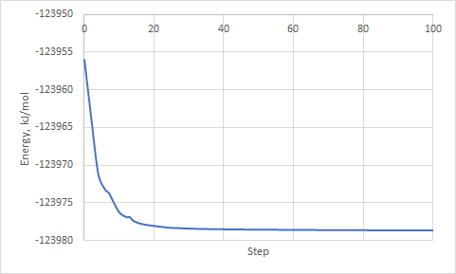
Result of the energy minimization
No do the steps (8)-(11) from the “Exercise 1”

Slide 21
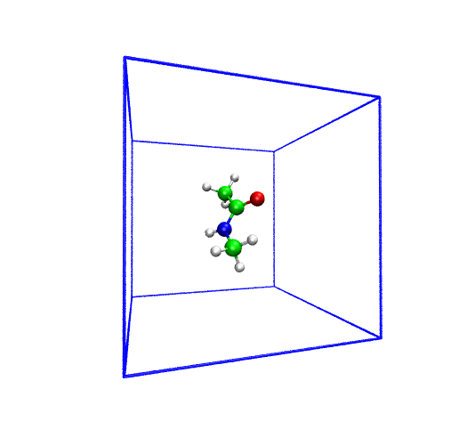
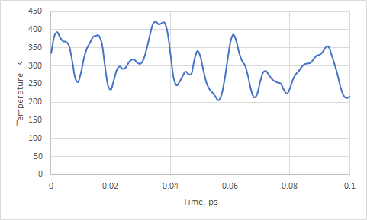
Result of the molecular dynamics with QM forces
Congratulations, you have done first QM simulation with GROMACS-CP2K Interface!

Slide 22
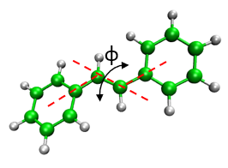
Exercise 2: Stilbene isomerization
Objective: Make isomerization Free-energy profile
QM subsystem : Stilbene (26 atoms)
MM subsystem : No
QM charge: 0
QM multiplicity: 1
Functional: PBE
Do the steps (1)-(7) from the “Exercise 2”

Slide 23
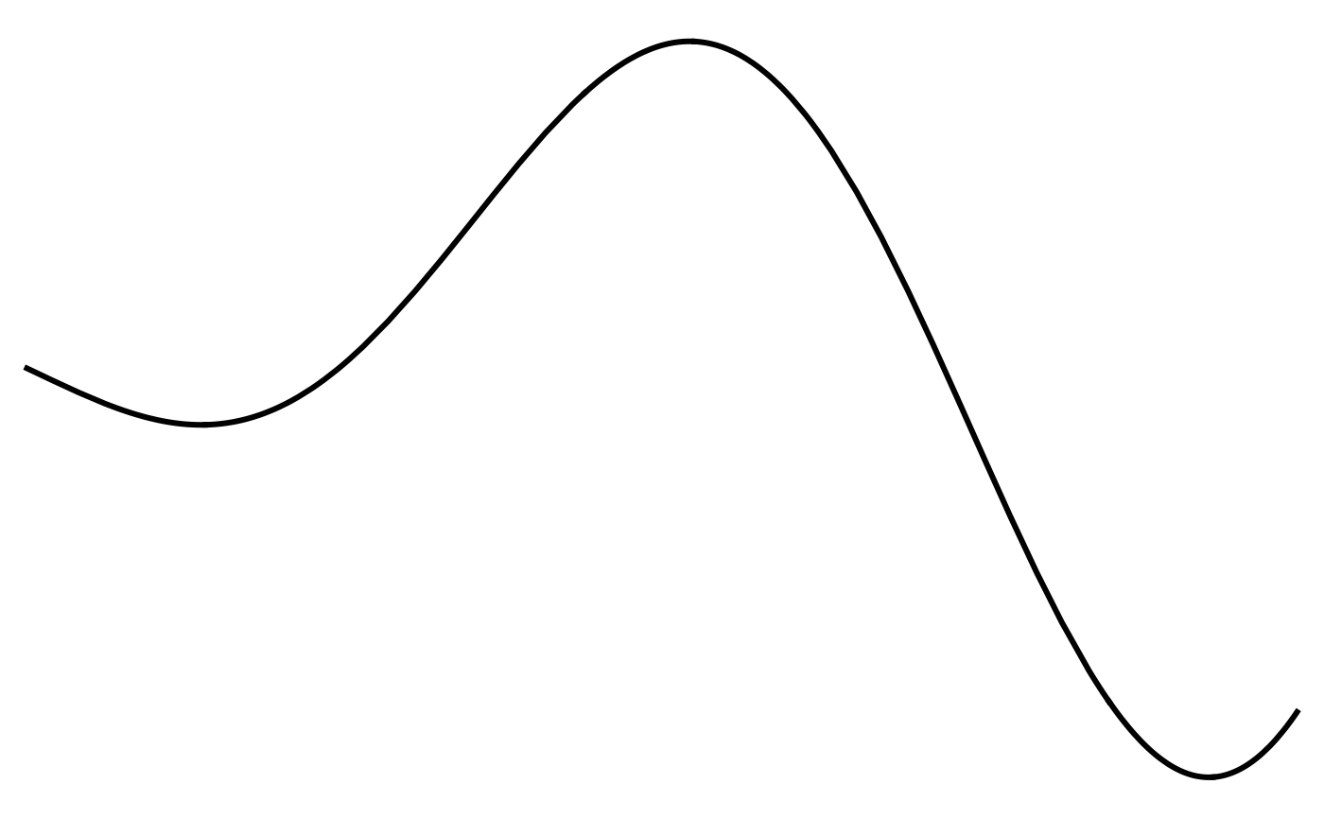
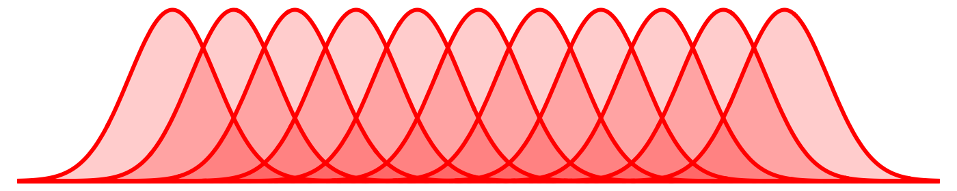
What is Umbrella sampling
System is stable in state A
System is stable in state B
The transitions between states are possible
--------------------------------------
We want to know what is the barrier ∆E and states relative free-energies ∆G
∆E
State A
Energy profile integrated from the coordinate distribution in each window
Sufficient overlap between windows needed
Gromacs has tool gmx wham to perform integration
State B
For further information please follow Umbrella sampling tutorial:
http://www.mdtutorials.com/gmx/umbrella/index.html

Slide 24
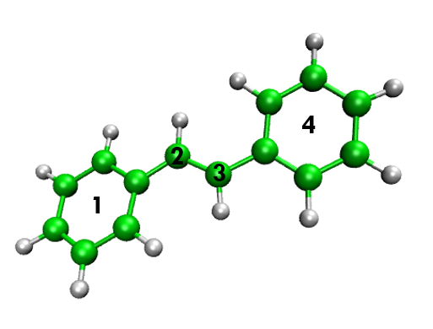
MDP Parameters: umbrella sampling
>> less qmmm_md_umbrella.mdp
pull = yes
pull_ncoords = 1 ; only one reaction coordinate
pull_ngroups = 4 ; four groups defining one reaction coordinate
pull_group1_name = group1 ; groups are defined in index file
pull_group2_name = group2
pull_group3_name = group3
pull_group4_name = group4
pull_coord1_type = umbrella
pull_coord1_geometry = dihedral
pull_coord1_dim = Y Y Y
pull_coord1_groups = 1 2 2 3 3 4
pull-coord1-init = -180 ; this is your angle value
pull_coord1_rate = 0.00 ; restrain in place
pull_coord1_k = 418.4 ; kJ mol^-1 nm^-2
pull-nstxout = 1 ; output pulling coordinate each step
pull-nstfout = 1 ; output pulling force each step

Slide 25
MDP Parameters: QM/MM
qmmm-active = true
qmmm-qmgroup = QMatoms
qmmm-qmmethod = PBE
qmmm-qmcharge = 0
qmmm-qmmultiplicity = 1

Slide 26
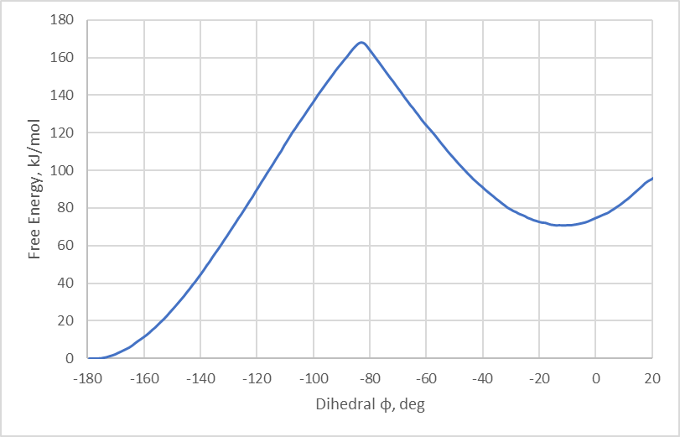
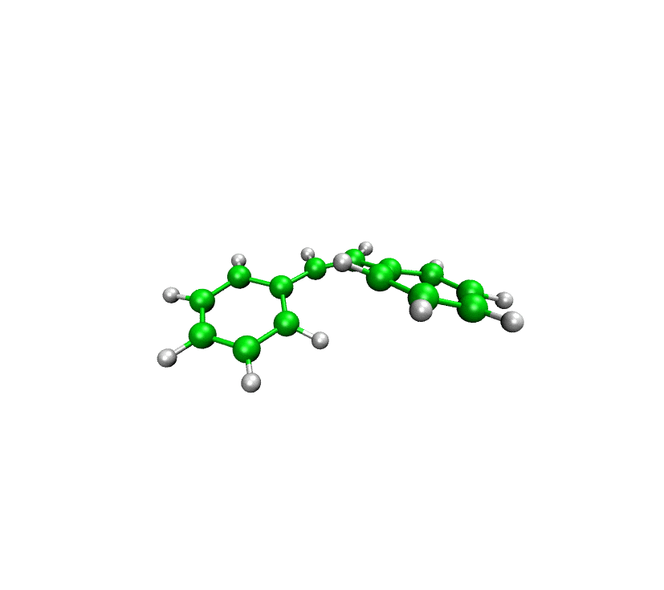
Isomerization free energy with MM forcefield
Amber14 Forcefield, Gromacs simulation, 1ns each window
>160 KJ/mol isomerization barrier. Lets see how it changes if we will go for QM simulation!
Do the part (9) from the “Exercise 2”

Slide 27
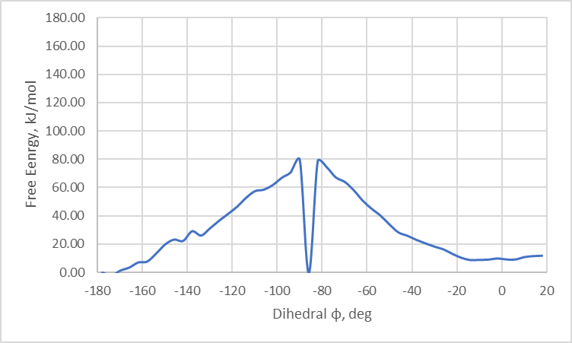
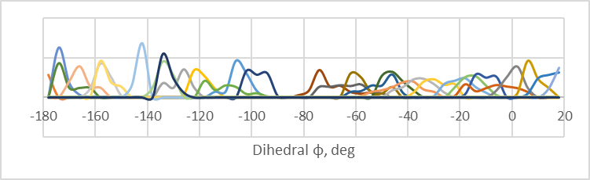
Isomerization free energy with QM
PBE, Gromacs-CP2K simulation for ~100fs (100 steps) for each frame
Heavily Under-sampled region

Slide 28
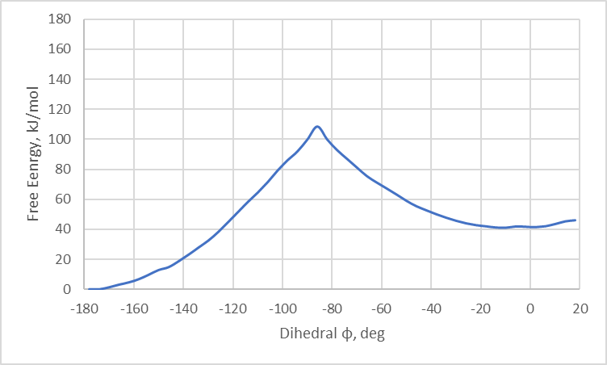
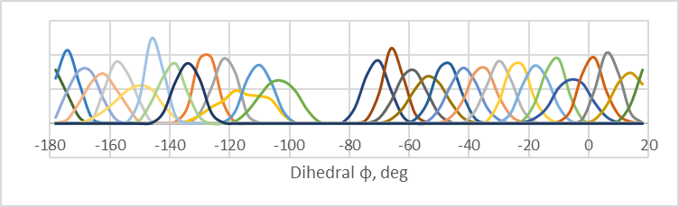
Isomerization free energy with QM
PBE, Gromacs-CP2K simulation extended to 10 ps (10000 steps)
Still under-sampled
For QM/MM suggested amount of sampling is at least 30-50 ps per window after extensive (1-10 ns) MM equilibration!

Slide 29
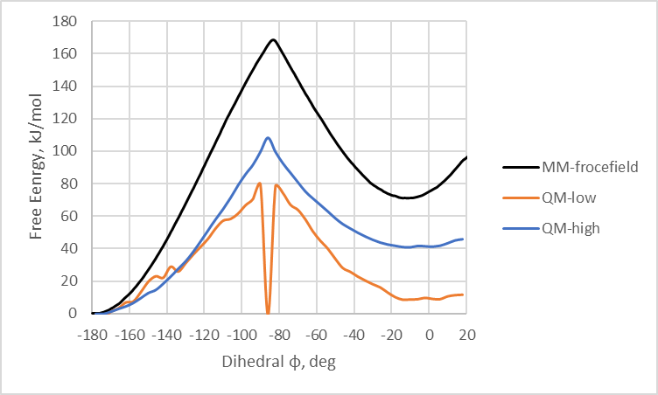
Isomerization free energy with QM
MM forcefield gives artificially high barrier
Questions?

Slide 30
End of the practical: GROMACS + CP2K Part I

Slide 31
Practical: GROMACS + CP2K Part II
Lecture recap (QM/MM, GEEP, PBC)
Setting up a QM/MM calculation with solvent
CP2K input and output
Large protein system setup

Slide 32
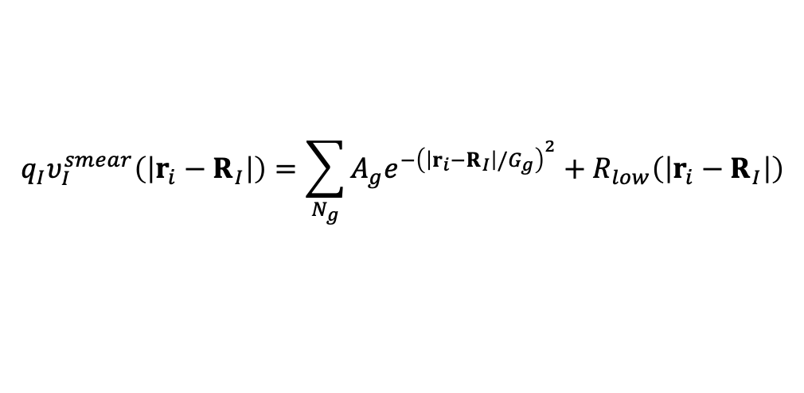
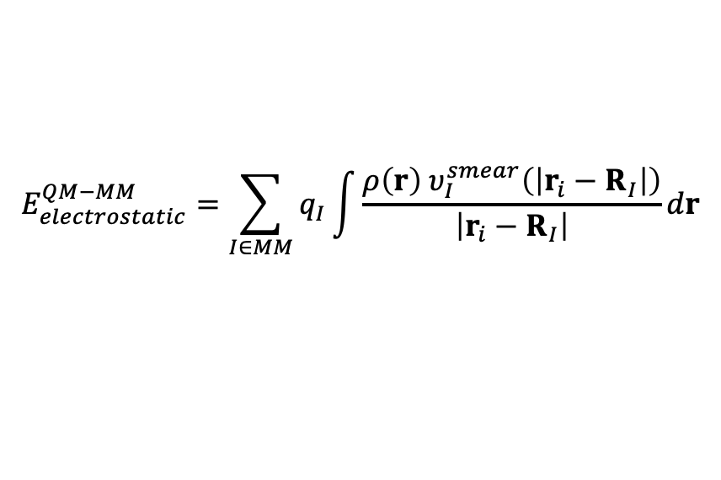
Lecture Recap: GEEP for QM/MM Coupling - CP2K
QM polarization due to the MM part included.
$$E_{electrostatic}^{QM−MM}=\sum_{I∈MM}{q_{I}\int{\frac{ρ\left(r\right){ υ}_{I}^{smear}\left(\left|r_{i}−R_{I}\right|\right)}{\left|r_{i}−R_{I}\right|}dr}}$$
MM
QM
$${q_{I}υ}_{I}^{smear}\left(\left|r_{i}−R_{I}\right|\right)=\sum_{N_{g}}{A_{g}e^{−{\left(\left|r_{i}−R_{I}\right|/G_{g}\right)}^{2}}+R_{low}\left(\left|r_{i}−R_{I}\right|\right)}$$
+
Real Space multi-grid approach

Slide 33
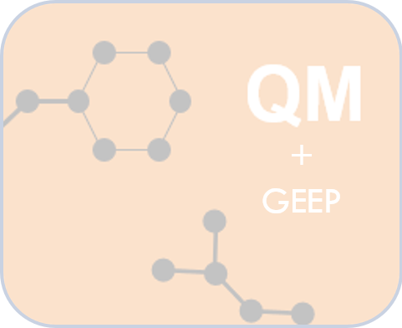
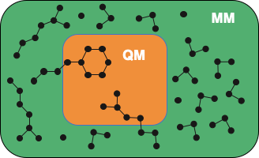

Fully periodic QM/MM
GEEP projects electrostatic potential from point charges onto the multi-grid of QM box
QM-QM periodic interactions are threated efficiently with Quickstep
Unless the QM and MM box have same dimensions the QM images over PBC will have incorrect periodicity
Blöchl scheme is used in CP2K to restore full system box periodicity
MM
Blöchl scheme
QM
De-coupling & Re-coupling
Laino, T; Mohamed, F; Laio, A; Parrinello, M. JOURNAL OF CHEMICAL THEORY AND COMPUTATION, 1 (6), 1176-1184 (2005).

Slide 34
Practical: GROMACS + CP2K Part II
Lecture recap (QM/MM, GEEP, PBC)
Setting up a QM/MM calculation with solvent
CP2K input and output
Large protein system setup

Slide 35
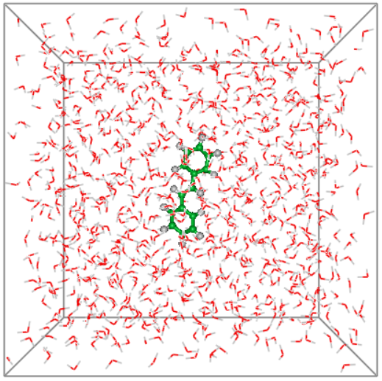
Exercise 3: Energy minimization with QM/MM
>> cd ../stilbene_water
Objective: Optimize system with QM/MM
QM subsystem : Stilbene
MM subsystem : 1001 waters with TIP3P parameters
QM charge: 0
QM multiplicity: 1
Functional: PBE
You can download and open stilbene-sol.pdb with PyMOL
Do the steps (1)-(4) from the “Exercise 3”

Slide 36
Practical: GROMACS + CP2K Part II
Lecture recap (QM/MM, GEEP, PBC)
Setting up a QM/MM calculation with solvent
CP2K input and output
Large protein system setup

Slide 37
Exercise 3: CP2K input files
Input Section: QMMM
&FORCE_EVAL
…
&QMMM !Definition of QM region and QM-MM coupling
&CELL ! QM Cell
A 9.720 0.000 0.000 ! Defined with three vectors A, B, C (in Angstroms)
B 0.000 21.740 0.000
C 0.000 0.000 7.500
PERIODIC XYZ ! Fully periodic cell
&END CELL
ECOUPL GAUSS ! QM-MM coupling method (GEEP)
USE_GEEP_LIB 12 ! Number of gaussian functions used in GEEP
…

Slide 38
Exercise 3: CP2K input files
Input Section: QMMM
&FORCE_EVAL
&QMMM !Definition of QM region and QM-MM coupling
…
&PERIODIC ! Treating periodic QM-MM
GMAX 1.0E+00
&MULTIPOLE ON ! Use Blöchl scheme (decoupling & re-coupling)
RCUT 1.0E+01
EWALD_PRECISION 1.0E-06
&END
&END PERIODIC
&QM_KIND H ! Hydrogen, which should be treated as QM atoms
MM_INDEX 2 4 6 9 11 13 15 18 20 22 24 26 ! Indexes of atoms starting from 1
&END QM_KIND
…
&END QMMM

Slide 39
Exercise 3: CP2K input files
Input Section: MM
&FORCE_EVAL
…
&MM ! MM region treatment
&FORCEFIELD
DO_NONBONDED FALSE ! Do NOT do MM-MM point charges and VdW interactions
&END FORCEFIELD
&POISSON
&EWALD
EWALD_TYPE NONE ! Do NOT do MM-MM periodic interactions
&END EWALD
&END POISSON
&END MM
…
GROMACS handles the description of the MM region!

Slide 40
Exercise 3: CP2K input files
Input Section: TOPOLOGY
&SUBSYS
…
&TOPOLOGY ! grompp will generate pdb with atomic charges for CP2K
COORD_FILE_NAME stilbene.pdb ! Make sure that files exists
COORD_FILE_FORMAT PDB
CHARGE_EXTENDED TRUE ! Read charges from PDB Extended Beta field (starting from column 81)
CONNECTIVITY OFF ! Do not read or generate bonds (MM treated by Gromacs)
&GENERATE
&ISOLATED_ATOMS ! Generate topology consisting of isolated atoms
LIST 1..26
&END
&END GENERATE
&END TOPOLOGY
…

Slide 41
Exercise 3: CP2K input files
>> less stilbene-sol-opt.inp
&FORCE_EVAL
...
&SUBSYS
…
&QM_KIND H
MM_INDEX 2 4 6 9 11 13 15 18 20 22 24 26
&END QM_KIND
&QM_KIND C
MM_INDEX 1 3 5 7 8 10 12 14 16 17 19 21 23 25
&END QM_KIND
…
&END SUBSYS
...
&END FORCE_EVAL
Only stilbene atoms marked as QM
Questions?

Slide 42
Exercise 3: CP2K input files
>> less stilbene-sol-opt.pdb
....
ATOM 22 C QM 1 18.947 14.687 16.609 1.00 0.00 C 0.000000
ATOM 23 H QM 1 19.399 13.704 16.735 1.00 0.00 H 0.000000
ATOM 24 C QM 1 17.563 14.803 16.517 1.00 0.00 C 0.000000
ATOM 25 H QM 1 16.951 13.902 16.556 1.00 0.00 H 0.000000
ATOM 26 O MM 2 1.816 6.680 1.359 1.00 0.00 O -0.834000
ATOM 27 H MM 2 0.966 6.696 1.800 1.00 0.00 H 0.417000
ATOM 28 H MM 2 1.615 6.408 0.463 1.00 0.00 H 0.417000
ATOM 29 O MM 2 1.559 2.257 10.377 1.00 0.00 O -0.834000
ATOM 30 H MM 2 1.900 2.175 11.268 1.00 0.00 H 0.417000
ATOM 31 H MM 2 1.127 1.420 10.208 1.00 0.00 H 0.417000
ATOM 32 O MM 2 31.142 4.832 6.637 1.00 0.00 O -0.834000
ATOM 33 H MM 2 30.197 4.943 6.736 1.00 0.00 H 0.417000
ATOM 34 H MM 2 31.238 4.242 5.889 1.00 0.00 H 0.417000
....
TIP3P water

Slide 43
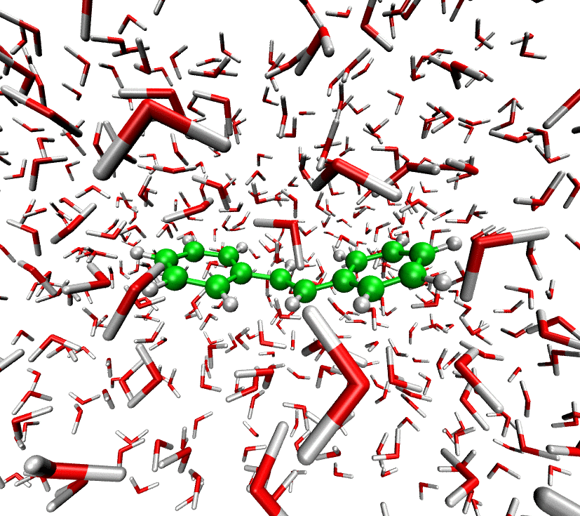
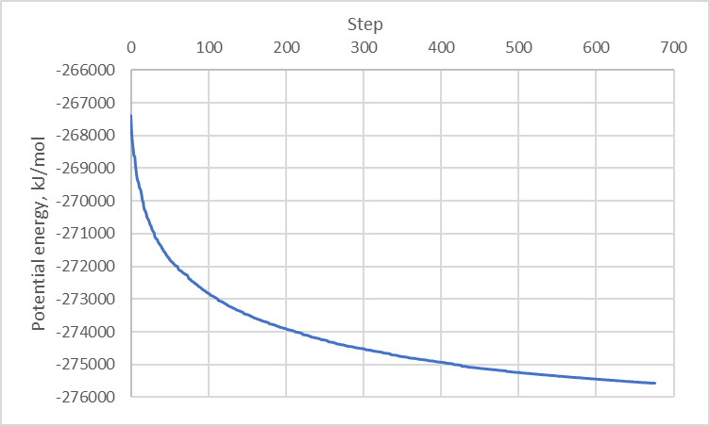
Exercise 3: results of energy minimization
Do step (6) of “Exercise 3”.
>> gmx_cp2k energy (reads data from ener.edr file)
….
> 6 (potential energy)
Download and open energy.xvg your need Grace to open file or copy data from file to Excel by columns

Slide 44
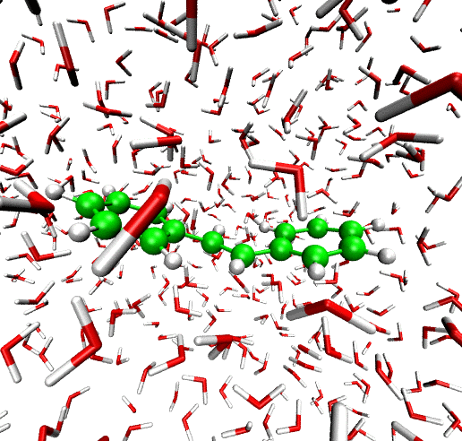
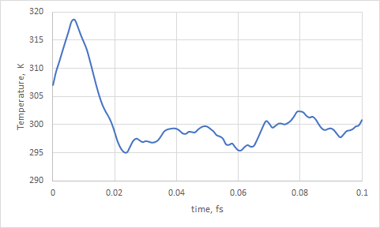
Exercise 3: MD simulations
Do steps (7)-(9) of “Exercise 3”

Slide 45
Practical: GROMACS + CP2K Part II
Lecture recap (QM/MM, GEEP, PBC)
Setting up a QM/MM calculation with solvent
CP2K input and output
Large protein system setup

Slide 46
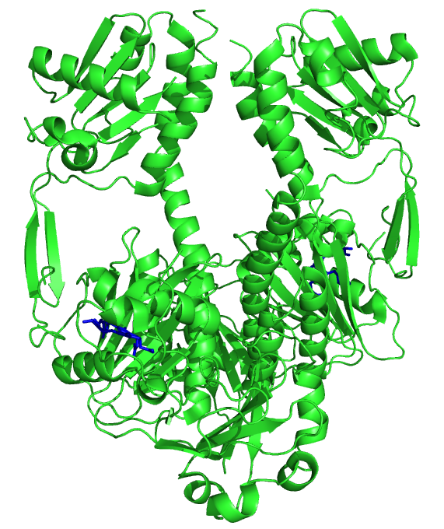
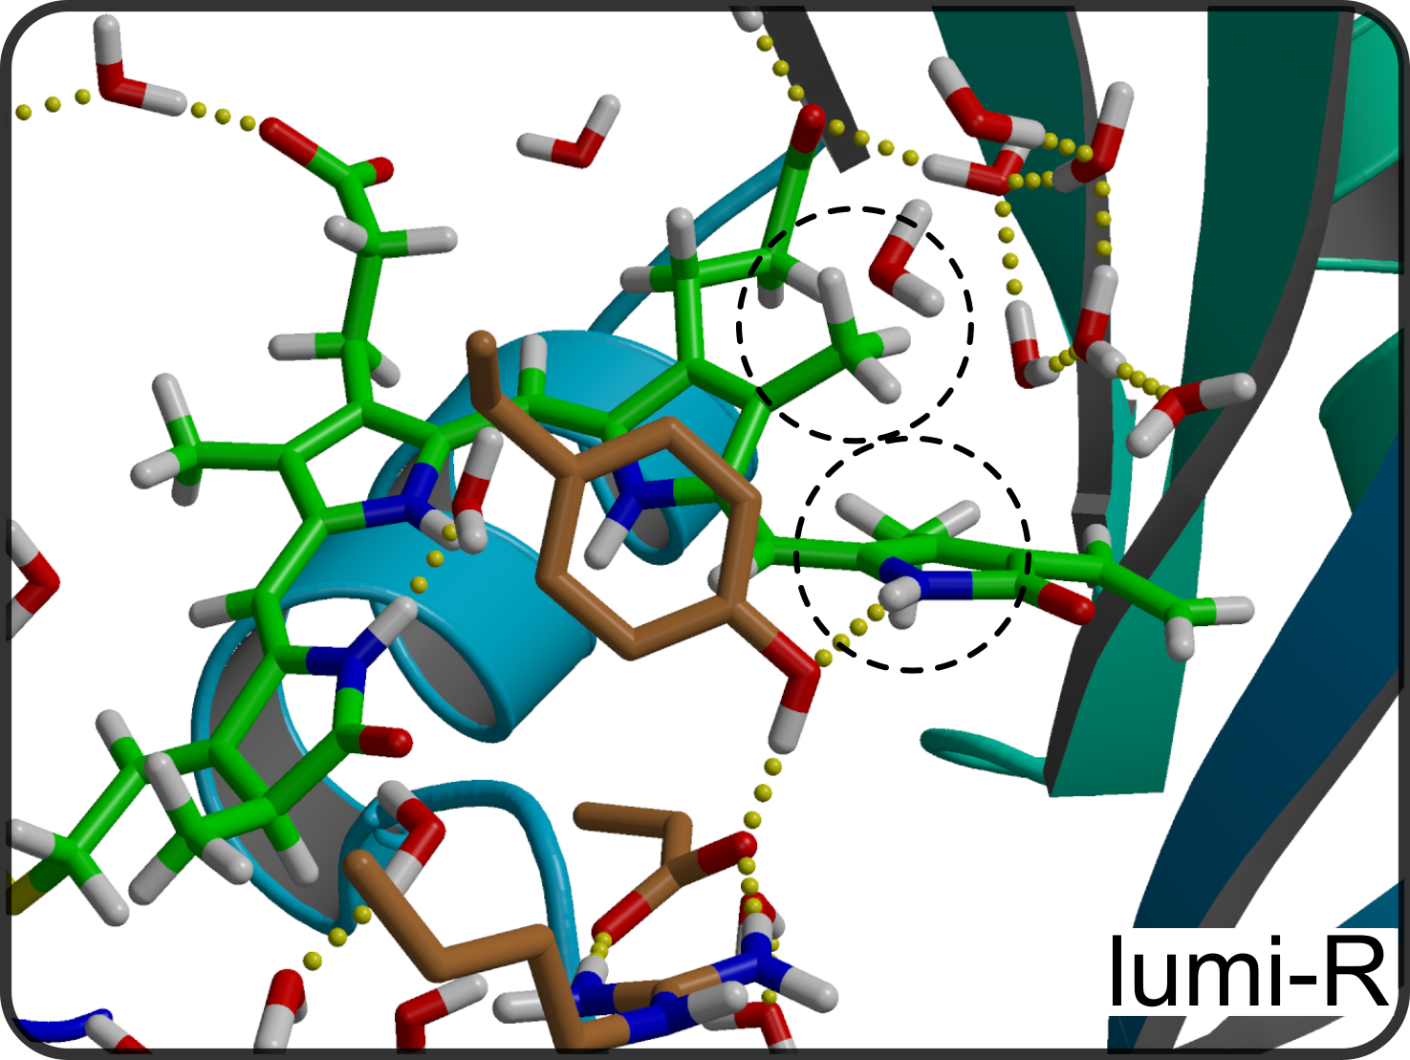
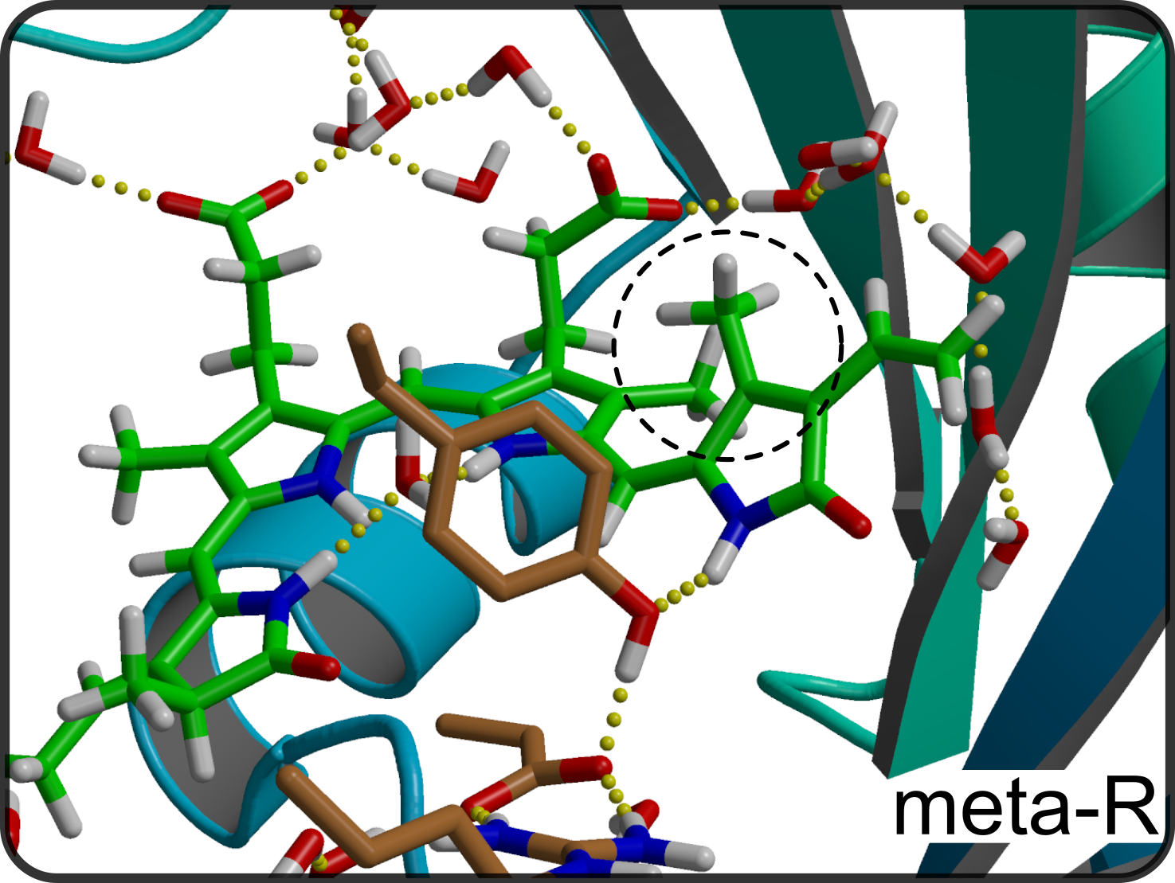
Exercise 4: Protein simulations
>> cd ../phytochrome
D-ring disposition from αf to βf in order of μs
Objective:
D-ring disposition energy barrier (α_{f} —> β_{f})
NEB + umbrella sampling simulations
QM part - Chromophore
QM method - PBE/DZVP-MOLOPT-GTH
MM Frocefield - Amber03
Do the steps (1)-(3) from the “Exercise 4”

Slide 47
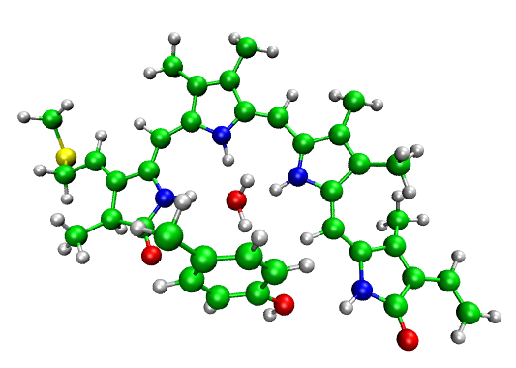
Exercise 4: Protein simulations
>> less phytochrome.inp
&FORCE_EVAL
...
&QMMM
…
&LINK
QM_INDEX 547
MM_INDEX 545
&END LINK
&LINK
QM_INDEX 4162
MM_INDEX 4160
&END LINK
&LINK
QM_INDEX 7987
MM_INDEX 7972
&END LINK
&LINK
QM_INDEX 7984
MM_INDEX 7978
&END LINK …
&END QMMM
...
&END FORCE_EVAL

Slide 48
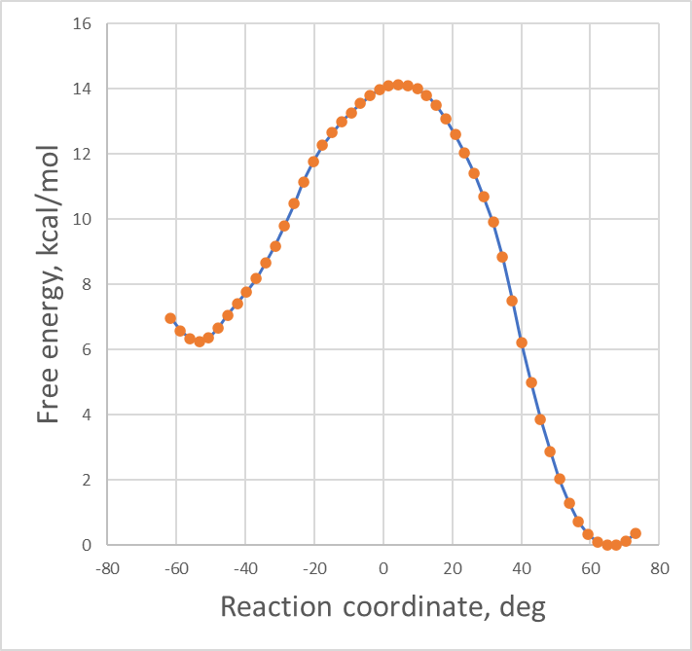
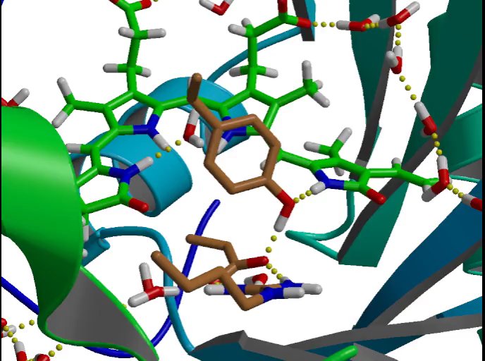
Protein simulations: umbrella sampling

Slide 49
End of the practical: GROMACS + CP2K Part II

Slide 51
Practical: GROMACS + CP2K Part III
Make protein QMMM system starting from the PDB structure
Usage of non-standard CP2K input parameters
Calculation of the absorption spectra for your system

Slide 52
Build protein system from pdb file
Input structure
SYSTEM SETUP
MD SIMULATIONS
QM/MM Calculations
- Missing residues
- Residue protonation
- pdb2gmx
- Define box
- Add solvent and ions
- ….
- Prepare .mdp files
- Energy minimization
- Pressure & temperature equilibration
- Production run
…
- Index file
- .mdp parameters for QM/MM
-External CP2K input (optional)
- Geometry optimization
- Atomic charges
- QM/MM MD
- Absorption spectra
- Umbrella Sampling
- ….

Slide 53
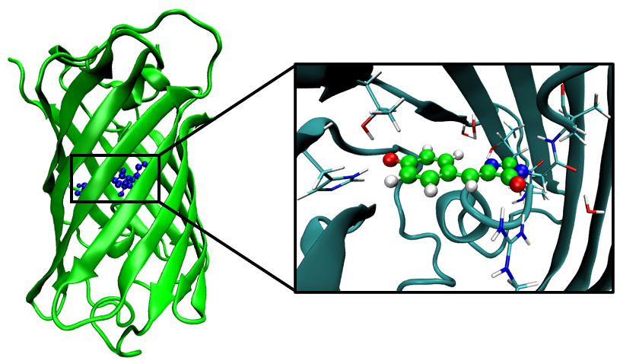
Exercise 5: build protein system from pdb file
>> cd egfp
Objective:
Make QM/MM model of EGFP protein and perform MD simulation
System:
QM part - Chromophore
QM method - PBE/DZVP-MOLOPT-GTH
MM Forcefield - Amber03
Do the steps (1)-(5) from the “Exercise 5” they are a pure MM simulations

Slide 54
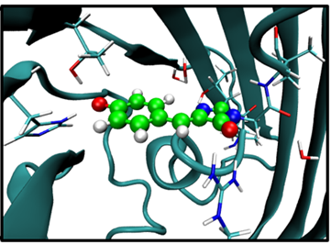
MDP Parameters: QM/MM
qmmm-active = true
qmmm-qmgroup = QMatoms
qmmm-qmmethod = PBE
qmmm-qmcharge = -1
qmmm-qmmultiplicity = 1

Slide 55
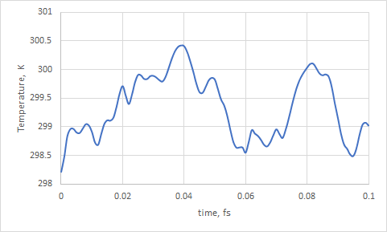
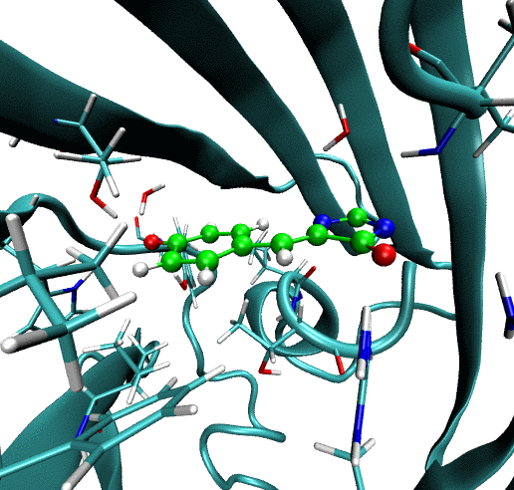
Exercise 5: build protein system from pdb file
Do the steps (6)-(9) from the “Exercise 5”

Slide 56
Practical: GROMACS + CP2K Part III
Make protein QMMM system starting from the PDB structure
Usage of non-standard CP2K input parameters
Calculation of the absorption spectra for your system

Slide 57
Exercise 6: using user-defined QM input file
Classical MD Simulations
- Index file
- .mdp parameters for QM/MM
- Your own CP2K input
QM/MM Calculations
qmmm-active = true ; Activates QMMM MdModule
qmmm-qmgroup = QMatoms ; Index group with QM atoms
qmmm-qmmethod = INPUT ; Provide your own input for CP2K
qmmm-qminputfile = cp2k.inp ; Input file to be used

Slide 58
Exercise 6: using user-defined QM input file
Objective:
Simulate UV/Vis absorption spectra of EGFP protein
System:
QM part - Chromophore
QM method - PBE/DZVP-MOLOPT-GTH TDDFT – for excitation energies
MM Frocefield - Amber03
Do the steps (1)-(5) from the “Exercise 6”

Slide 59
Exercise 6: using user-defined QM input file
egfp-qmmm-spec.inp
&FORCE_EVAL
...
&DFT
…
&END DFT
&PROPERTIES ! Request additional properties to be calculated after SCF
&TDDFPT ! TDDFT excitations
NSTATES 5 ! Number of excited states to calculate
MAX_ITER 10 ! Maximum Davidson diagonalization Iterations to be performed
CONVERGENCE [eV] 1.0e-3 ! Convergence of energies in eV
&END TDDFPT
&END PROPERTIES
...
&END FORCE_EVAL

Slide 60
Exercise 6: using user-defined QM input file
less md-qmmm-spec.mdp
; CP2K QMMM parameters
qmmm-active = true ; Activate QMMM MdModule
qmmm-qmgroup = Qmatoms ; Index group of QM atoms
qmmm-qmmethod = INPUT ; Method to use
qmmm-qminputfile = egfp-qmmm-spec.inp ; external input file

Slide 61
Practical: GROMACS + CP2K Part III
Make protein QMMM system starting from the PDB structure
Usage of non-standard CP2K input parameters
Calculation of the absorption spectra for your system

Slide 62
Exercise 6: TDDFT excitations
>> less egfp-qmmm-spec.out
Results of TDDFT calculation will look like that:
R-TDDFPT states of multiplicity 1
State Excitation Transition dipole (a.u.) Oscillator
number energy (eV) x y z strength (a.u.)
------------------------------------------------------------------------
TDDFPT| 1 2.00058 -3.5991E-02 -5.4149E-02 -7.9349E-03 2.10286E-04
TDDFPT| 2 3.08318 1.3797E+00 -1.7284E-01 6.5479E-01 1.78424E-01
TDDFPT| 3 3.22153 2.4009E+00 -9.8621E-01 1.1151E+00 6.29837E-01
TDDFPT| 4 3.54032 -4.8474E-01 -1.9293E-01 -9.7242E-02 2.44295E-02
TDDFPT| 5 3.55772 -5.5083E-01 3.7988E-01 -2.2543E-01 4.34543E-02
We can gather that information over the trajectory:
>> grep "TDDFPT|" egfp-qmmm-spec.out | awk '{ print $3 " " $7 }' > excitations
Do the step (7) from the “Exercise 6

Slide 63
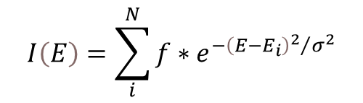
Exercise 6: convolving the spectra
>> less excitations
E_{i}, eV
f, a.u.
2.00058 2.10286E-04
3.08318 1.78424E-01
3.22153 6.29837E-01
3.54032 2.44295E-02
3.55772 4.34543E-02
2.04421 2.02664E-04
3.10716 1.86226E-01
3.24825 6.34929E-01
3.56783 3.07195E-02
3.59003 4.00265E-02
2.13146 2.12315E-04
3.12118 1.43032E-01
3.30321 7.14998E-01
3.61706 5.70336E-02
3.67955 2.27674E-02
$$I\left(E\right)=\sum_{i}^{N}{{f∗e}^{−{{\left(E−E_{i}\right)}^{2}}/{σ^{2}}}}$$
σ – parameter defining gaussians half-width
For example 0.1 eV in that case
Do the step (8) from the “Exercise 6

Slide 64
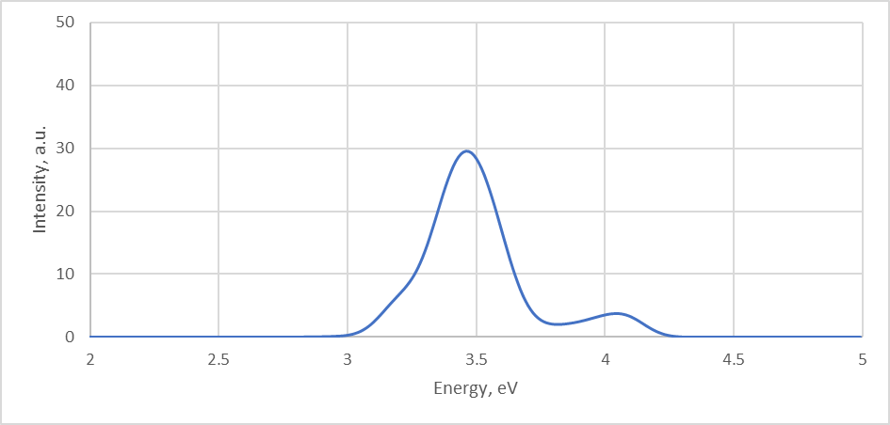
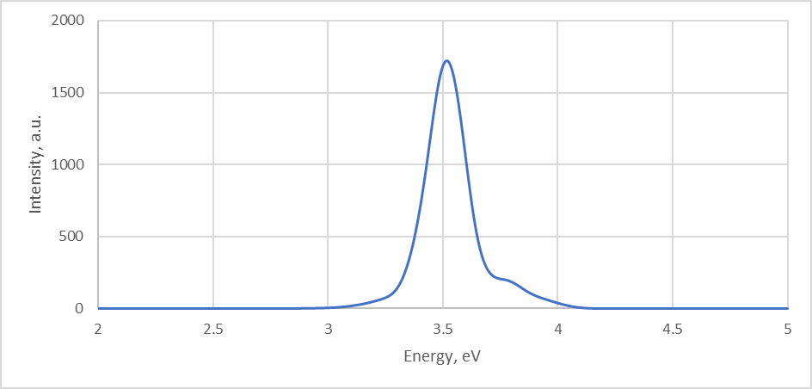
Exercise 6: Results
After 100fs sampling
After 3ps sampling

Slide 65
1) CP2K parameters and best practices:
Further information
https://docs.bioexcel.eu/qmmm_bpg/en/main/
2) Best practices in QM/MM webinar series:
https://bioexcel.eu/events/virtual-workshop-best-practices-in-qm-mm-simulation-of-biomolecular-systems/
3) Bioexcel YouTube channel:
https://www.youtube.com/c/BioExcelCoE/videos

